Slide 1
Unit -7 Lecture : 13 and 14
Theory of Cost :
Definition of Different costs,
Relationship Between Different Costs and Cost Curves,

Slide 2
OBJECTIVES
At the end of this unit, you should be able to:
enumerate cost concepts and their definitions
differentiate between total cost schedule and cost curve
explain marginal cost and average cost relationship
discuss short-run and long-run average costs relationship.

Slide 3
Definition of cost : The cost of production of an individual firm operating in a market has an important influence on the market supply of a commodity. It is very necessary to have a clear idea about the concept of cost of production and then proceed to study the cost curves. The firm’s cost are the expenses producing the goods or services sold during the period.

Slide 4
Fixed costs
Fixed costs are those costs that do not vary with output. The fixed costs are rent for factory or office space, contractual payments for equipment, interest payments on debts, and so forth. These must be paid even if the firm produce no output, and they will not change if output changes.

Slide 5
Variable Cost : Variable costs are those costs that do vary output. The variable costs are raw materials used in the making of the commodity as well as the costs of causal or daily labour employed. They are incurred only when the factory is at work. In the long-run, all costs are variable. Thus in the long-run, fixed costs are zero.

Slide 6
Total Costs : Total costs equal to fixed costs plus variable costs. Total cost represents the lowest total money expense needed to produce each level of output.
Overall sum of total fixed and variable costs incurred in the production process .
TC= (TFC +TVC).

Slide 7
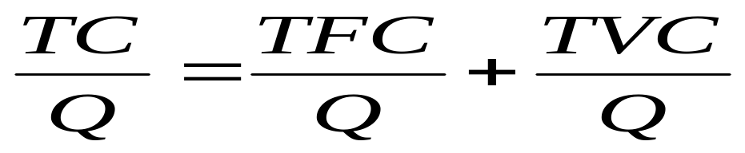
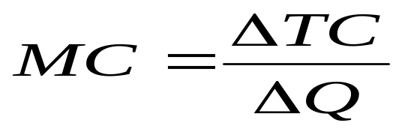
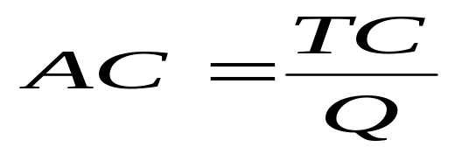
Average Costs : Average costs equal to total costs divided by number of quantity.
Marginal costs: Marginal cost is the extra cost associated with producing one more unit of output.
ATC = AFC + AVC

Slide 8
Now we can illustrate the concept of all costs in the following table :
Quantity (Q) | Total Fixed Cost (TFC) | Total Variable Cost (TVC) | Total Cost (TC) | Average Total Cost (ATC) | Marginal Cost (MC) | Average Fixed Cost (AFC) | Average Variable Cost (AVC)
1 | 30 | 10 | 40 | 40 | --- | 30 | 10
2 | 30 | 18 | 48 | 24 | 8 | 15 | 9
3 | 30 | 24 | 54 | 18 | 6 | 10 | 8
4 | 30 | 32 | 62 | 15.50 | 8 | 7.50 | 8
5 | 30 | 50 | 80 | 16 | 18 | 6 | 10
6 | 30 | 72 | 102 | 17 | 22 | 5 | 12

Slide 9
Total Cost Schedule and Cost Curve
A table showing the units produced and the amount of fixed and variable costs input into its production at different output depict the Total cost schedule.
Cost curves shows the relationship between the level of output and the cost of producing that output. Output is on the horizontal axis and cost is on the vertical axis.

Slide 10
Cost curves show what happens to costs of production as the level of output changes.
In the above table, different cost measures are provided. Together, they make up the family of costs.
Note: TO is equal to quantity, ‘q’. Therefore instead of saying that AVC = TVC/TO, it can be rewritten as TVC/Q.

Slide 11
Cost Cost
TC
MC
ATC
AVC
TVC
TFC
0 0 AFC
Output Output
w

Slide 12
SELF-ASSESSMENT EXERCISE
Differentiate between Total Cost Schedule and Cost Curves.
Show graphically the relationship between Total Fixed Cost and Total Variable Cost.
Define the following terms:
a. Total fixed cost b. Total output c. Average cost
d. Marginal cost e. Total cost schedule

Slide 13
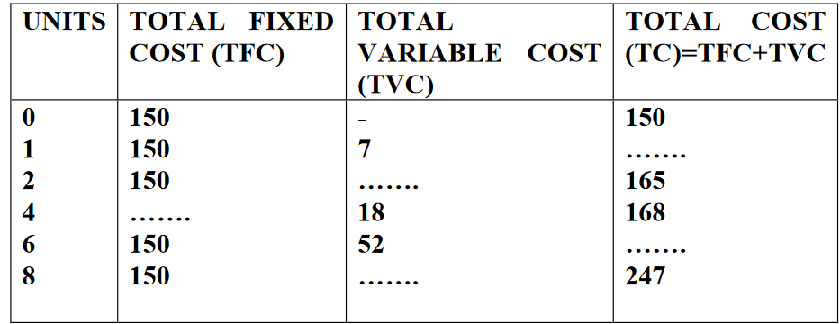
Below is a hypothetical Total Cost Schedule, calculate and fill in the missing figures.

Slide 14
Reference
Samuelson, P. A. & Nordhaus, W. D. (2010). Economics. (9th ed.). New York: McGraw Hill Companies.

Slide 15
Why the LRAC curve is U – shaped ?
Recall that in the long – run all costs are variable; therefore, there is no distinction between long – run variable and total costs – there is only long – run average cost. The long – run average cost curve shows the minimum average cost for each level of output when all factor inputs are variable and when factor prices are fixed. The long – run average cost curve is U-shaped because, first, economies of scale, then constant returns to scale, and finally diseconomies of scale as output expands.

Slide 16
Economies of Scale : The declining portion of the long – run average cost (LRAC) curve is due to economies of scale that arise out of the indivisibility of the inputs of labour and physical capital goods or equipment. Economies of scale can occur because of the greater productivity of specialization in any of a variety of areas, including technological equipment, marketing, research and development, and management. As the output of an enterprise increases will all inputs variable average costs will decline because of the economies of scale associated with increased specialization of labour, management, plant, and equipment. Economies of scale are present when equal percentage changes in the use of inputs lead to larger percentage changes in output.

Slide 17
Constant Returns to Scale : Economies of scale will become exhausted at some point when expanding output no longer increases productivity. The evidence suggests that for a large range of outputs there will be constant returns to scale, where the average costs of production remain constant. Constant returns to scale are present when a given percent change in all inputs result in the same percent change in output.

Slide 18
Cost
Economies of Constant Return to Diseconomies of
Scale Scale Scale
0
Quantity of Output
C

Slide 19
Diseconomies of Scale : As the enterprise continues to expand its output, eventually all the economies of large – scale production will be exploited and long – run average cost will begin to rise. The rise in long – run average costs as the capital stock of the enterprise expands due to diseconomies of scale. Diseconomies of scale are present when an equal percentage change in inputs leads to a smaller percentage change in output.
The long – run average cost curve is the envelope of the short – run average total cost curves. The long – run average cost curve is U – shaped. The declining portion shows economies of scale. The rising portion shows diseconomies of constant returns to scale.

Slide 20

Application : Managerial decision making is facilitated by information that shows the cost of each rate of output. Consider a production process that combines variable amounts of labour with a fixed capital stock, say, 10 machines. In this process, the rate of production is changed by varying rate of labour input. Assume that the firm can vary the labour input freely at a cost of $100 per unit of labour per period. Therefore, the expenditure for labour is the variable cost. Again, assume that the variable cost equation is -
Find :
i) Total Fixed Cost; ii) Total Cost Equation;
iii) The rate of output that results in minimum average variable cost.

